Slide 1
Online recruitment system
Group-1
Mentor
Vishal Mali

Slide 2
Requirement Understanding
The actors are classified into 3 types
Admin –can generate placement reports
Company-can add/modify company details and can post jobs
User-can add/modify Resume and can search/apply for jobs.

Slide 3
modules
LOGIN
REGISTRATION
ADD PERSONAL DETAILS
MODIFY PERSONAL DETAILS
ADD QUALIFICATION DETAILS
MODIFY QUALIFICATION DETAILS
ADD WORK HISTORY DETAILS
MODIFY WORK HISTORY DETAILS
SEARCH AND APPLY JOBS

Slide 4
MODULES
LOGIN MODULE:
Login module is common for all the users of the system
Basic functionality of module are as follows:
Taking login credentials from the user.
If given credentials are wrong, show appropriate message.
If login succeeds, user will be navigated to his/her respective page as per his/her role.

Slide 5
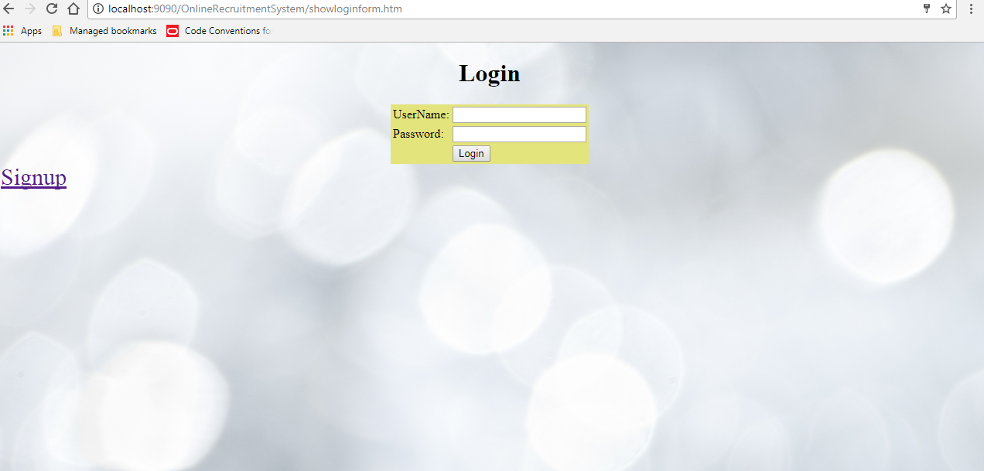

Slide 6
MODULES
Registration Module:
It is compulsory for all the visitors to Signup in order to use the portal.
Visitor will be asked to enter the following details:
User Name
Password
Note: If the user name already exists then the visitor will be asked to change the username.

Slide 7
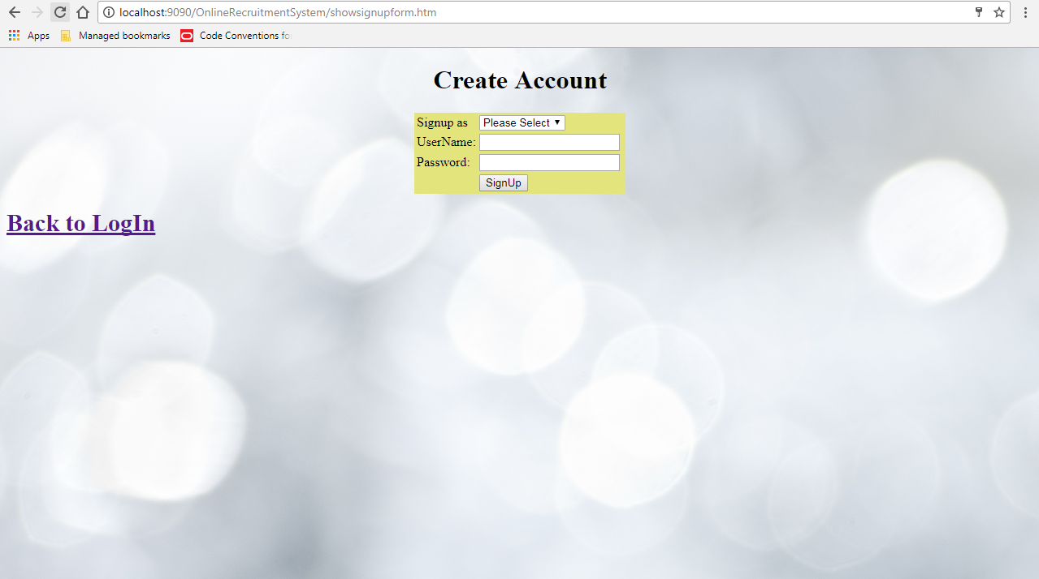

Slide 8
MODULES
ADD PERSONAL DETAILS
In this module ,the user can add his personal details and can save them
The user id is taken from login module to make sure that one user has only one set of personal details.
Assumption: One user can add only one set of personal details.

Slide 9
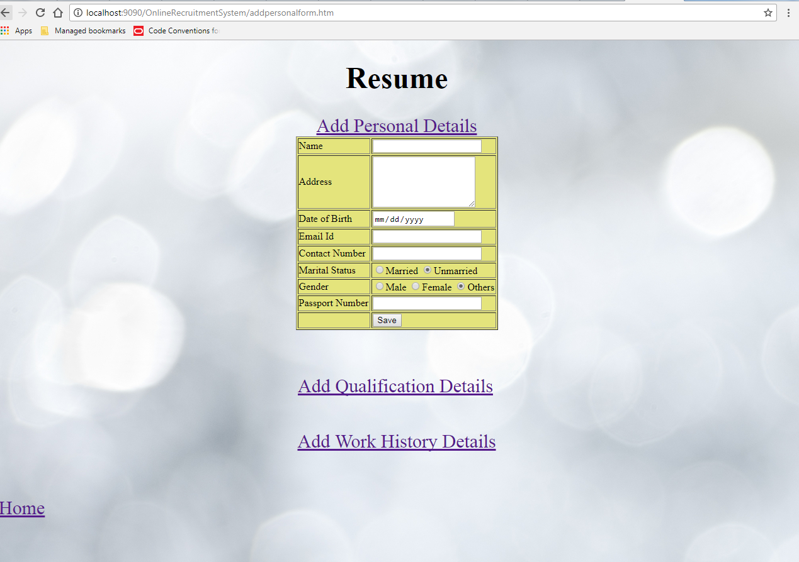

Slide 10
MODULES
MODIFY PERSONAL DETAILS
This module is used to modify the personal details that the user had saved in add personal details module.
A table consisting of all his personal details will be displayed and the user can modify those accordingly.
Note: In order to modify any details the user had to first add them.

Slide 11
MODULES
ADD QUALIFICATION DETAILS
In this module ,the user can add his Qualification details and can save them
The user id is taken from login module to make sure that one user has only one set of Qualification details.
Assumption: One user can add only one set of Qualification details.

Slide 12
MODULES
MODIFY QUALIFICATION DETAILS
This module is used to modify the qualification details that the user had saved in add qualification details module.
A table consisting of all his qualification details will be displayed and the user can modify those accordingly.
Note: In order to modify any details the user had to first add them.

Slide 13
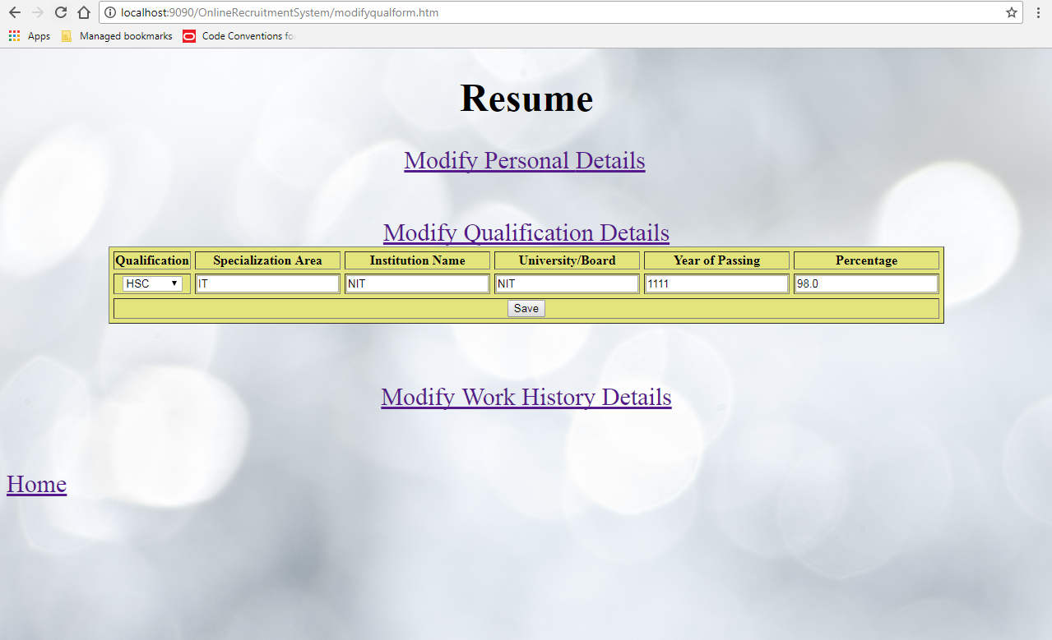

Slide 14
MODULES
ADD WORK HISTORY DETAILS
In this module ,the user can add his Work History details and can save them
The user id is taken from login module to make sure that one user has only one set of Work History details.
Assumption: One user can add only one set of Work History details.

Slide 15
MODULES
MODIFY WORK HISTORY DETAILS
This module is used to modify the Work History details that the user had saved in add qualification details module.
A table consisting of all his Work History details will be displayed and the user can modify those accordingly.
Note: In order to modify any details the user had to first add them.

Slide 16
MODULES
SEARCH AND APPLY JOBS:
The user can search jobs based on 4 criteria
Qualification
Location
Work Experience
Designation
When the user clicks on search, list of jobs with selected criteria are displayed with APPLY option next to them.
When the user clicks on Apply ,his application will be submitted and an auto-generated application Id is displayed.

Slide 17
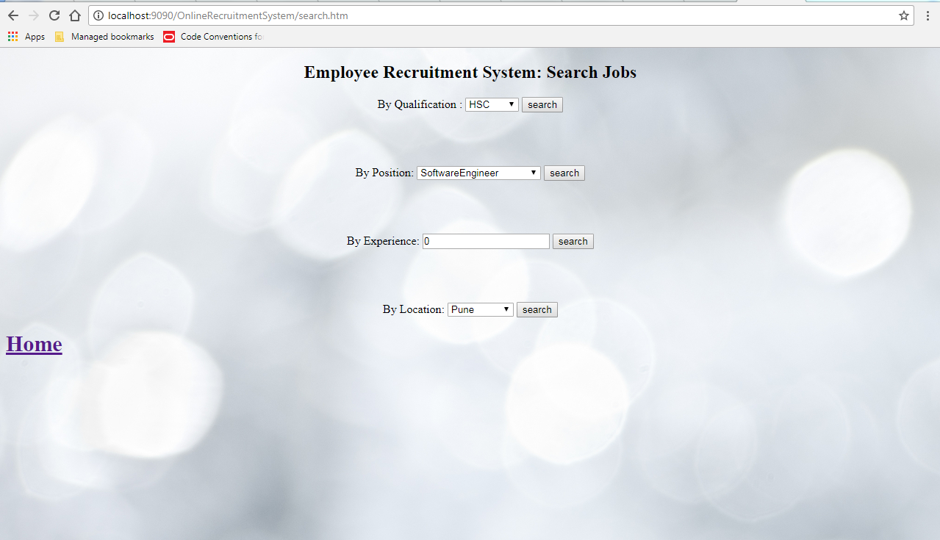

Slide 18
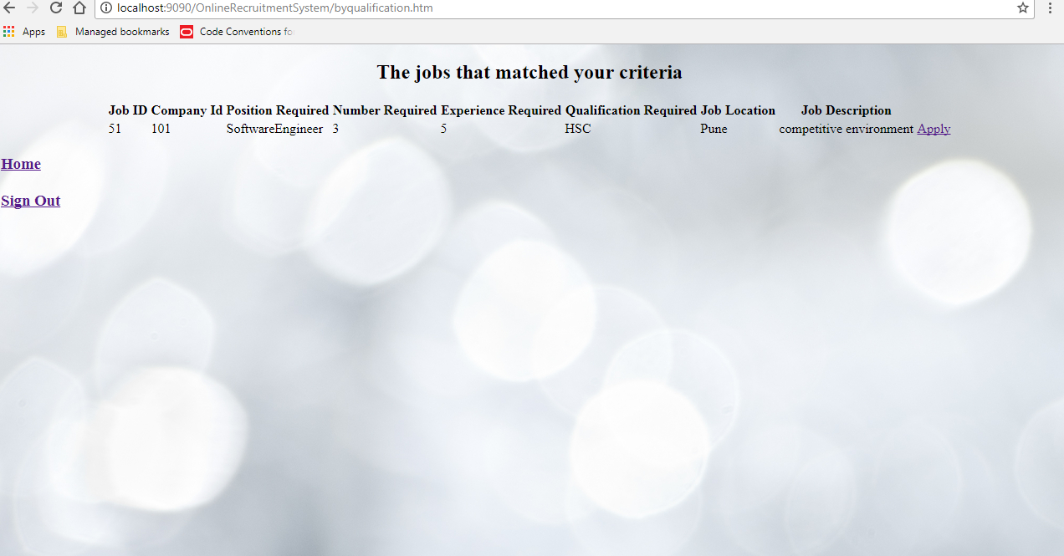

Slide 19
THANK YOU

